Slide 1


DEALING WITH IMBALANCED DATA FOR GPS TRAJECTORY OUTLIER DETECTION
Le Van Quoc Anh Faculty of Information Technology
Ho Chi Minh City University of
Transport Ho Chi Minh City, Vietnam anh@ut.edu.vn
Nguyen Van Chien Faculty of Information Technology Ho Chi Minh City University of Transport
Ho Chi Minh City, Vietnam chiennguyensrdn@gmail.com
Van-Hau Nguyen Faculty of Information Technology Hung Yen University of Technology and Education Hung Yen, Vietnam haunv@utehy.edu.vn

Slide 2

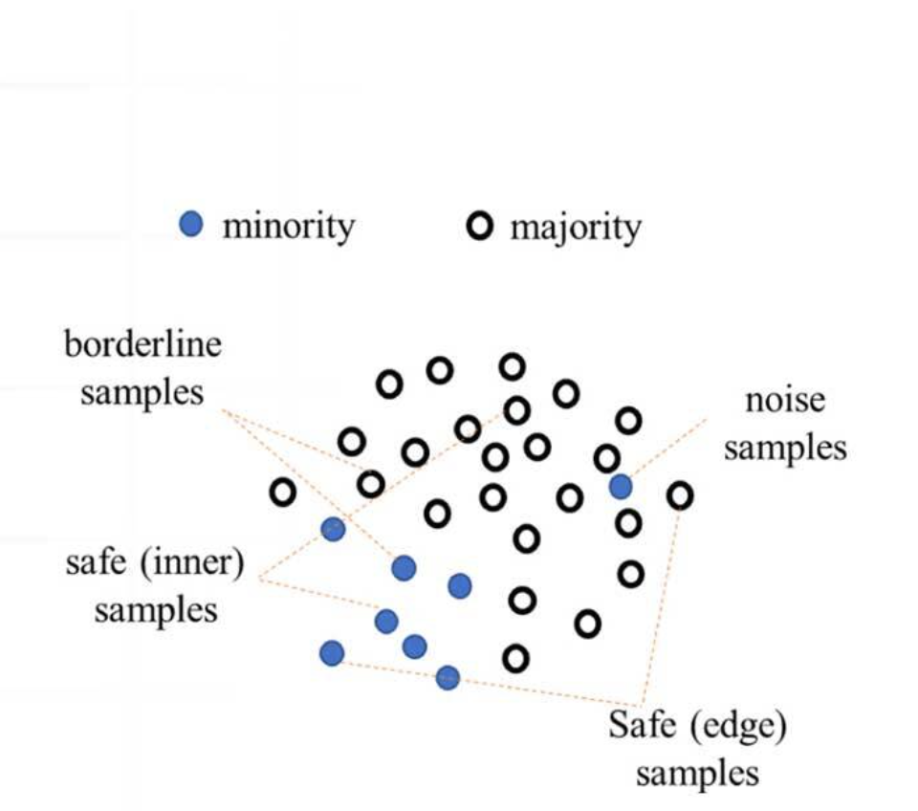
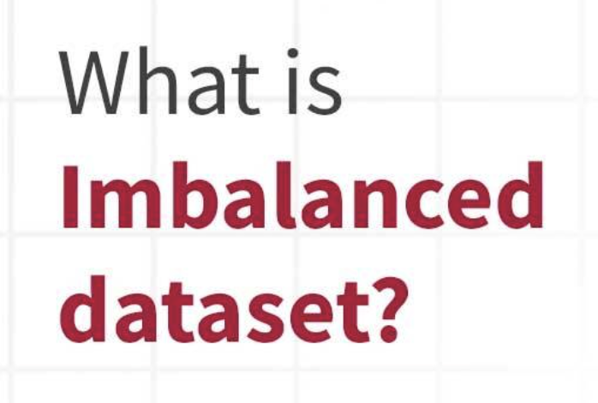

Slide 3
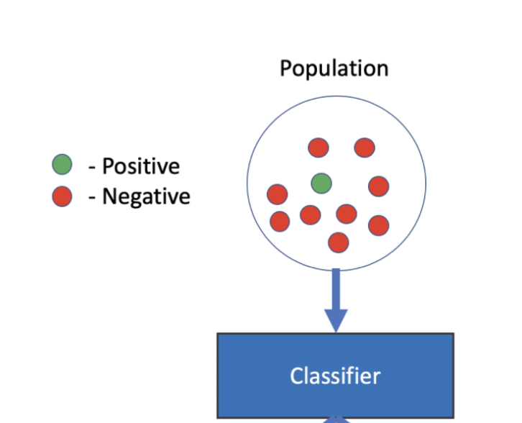

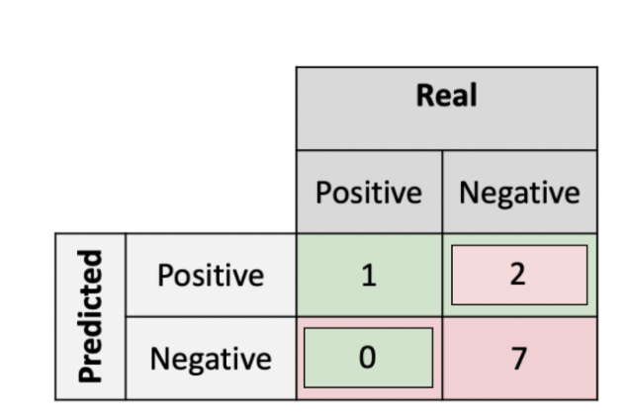
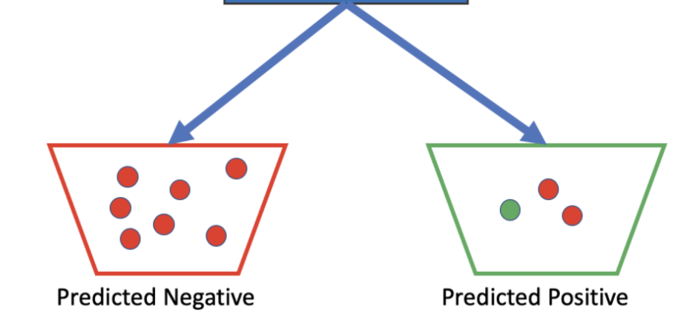
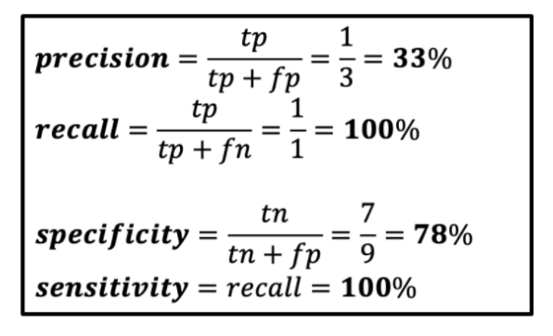
NATURE OF THE PROBLEM
Notes:
Technically speaking, any data set that exhibits an unequal distribution between its classes can be considered imbalanced
Class imbalances on the ratio of 100:1, 1,000:1, and 10,000:1
=>Leading to overfitting
With the majority class having close to 100 percent accuracy and the minority class having accuracies of 0-10 percent
Suppose a classifier achieves 10 percent accuracy on the minority class => what happens?
overwhelmingly expensive
serious consequences

Slide 4
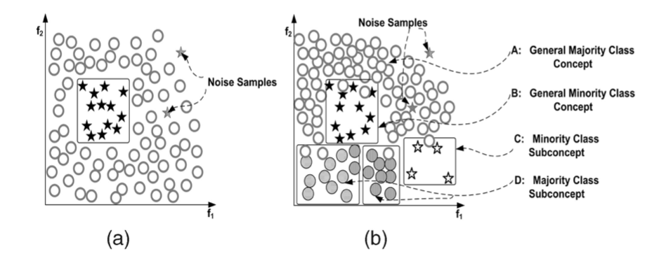
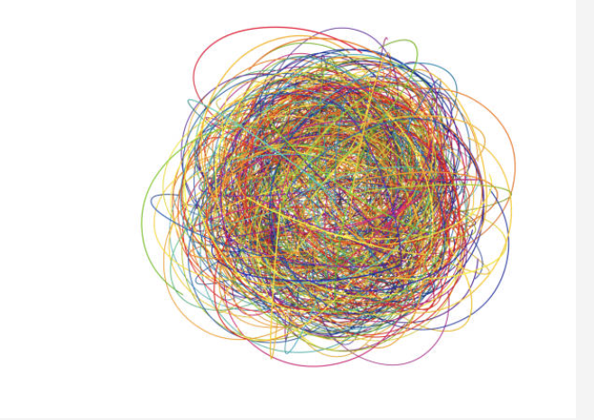
Data complexity
A data set with a between-class imbalance.
A high-complexity data set with between-class and within-class imbalances, multiple concepts, overlapping, noise, and lack of representative data.
Notes:
Data complexity is a broad term that comprises issues such as overlapping, lack of representative data, small disjuncts, and others.
=>imbalance is not the only factor that hinders learning
As it turns out, data set complexity is the primary determining factor of classification deterioration, which, in turn, is amplified by the addition of a relative imbalance.

Slide 5
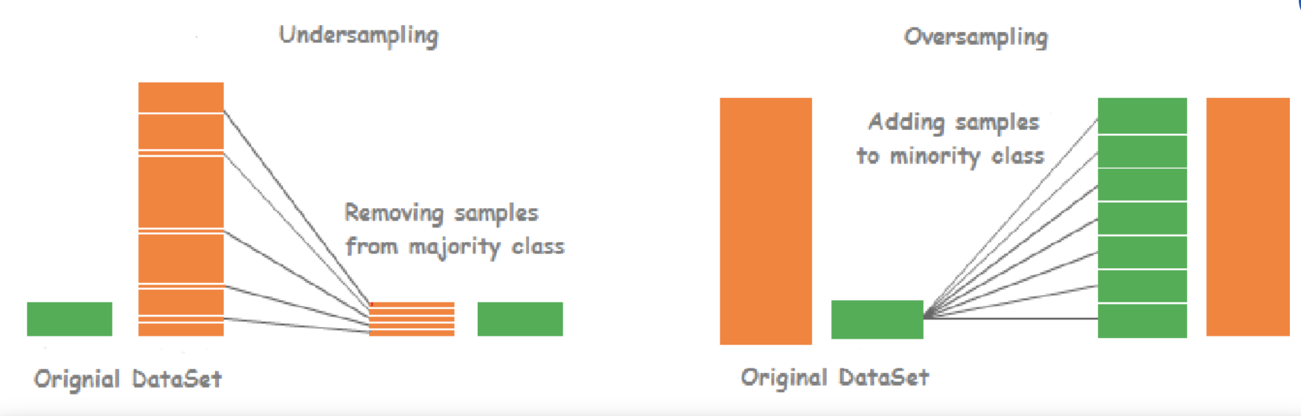
THE STATE-OF-THE-ARTSOLUTIONS
Notes:
Random Oversampling and Undersampling

Slide 6
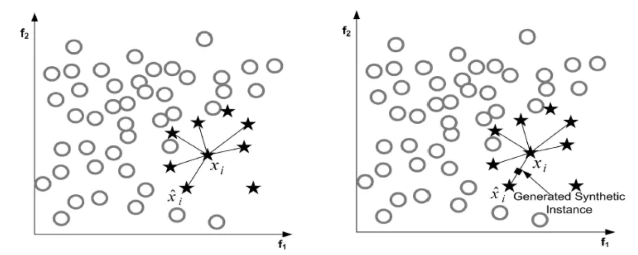

THE STATE-OF-THE-ARTSOLUTIONS
Synthetic Sampling with Data Generation (SMOTE)
$$x_{new} ={ x}_{i}+ ( \hat{x_{j}} −{ x}_{i}) δ$$
Notes:
SMOTE

Slide 7

THE STATE-OF-THE-ARTSOLUTIONS
Algorithm SMOTE
$E=∅$
Procedure SMOTE:
for each $x_{i}$ in $S_{min }$:
j=0
while(j<K):
$δ =Random.Uniform [0,1]$
$x_{new} ={ x}_{i}+ ( \hat{x_{j}} −{ x}_{i}) δ$
$E add item x_{new}$
j+=1
end while
end for
end Procedure
Notes:
SMOTE

Slide 8
THE STATE-OF-THE-ARTSOLUTIONS
In the SMOTE algorithm, the problem of overgeneralization is largely attributed to the way in which it creates synthetic samples.
Specifically, SMOTE generates the same number of synthetic data samples for each original minority example and does so without consideration of neighboring examples, which increases the occurrence of overlapping between classes.
→To this end, various adaptive sampling methods have been proposed to overcome this limitation:
Adaptive Synthetic Sampling (ADA-SYNC)
Border- line-SMOTE
SVM-SMOTE

Slide 9
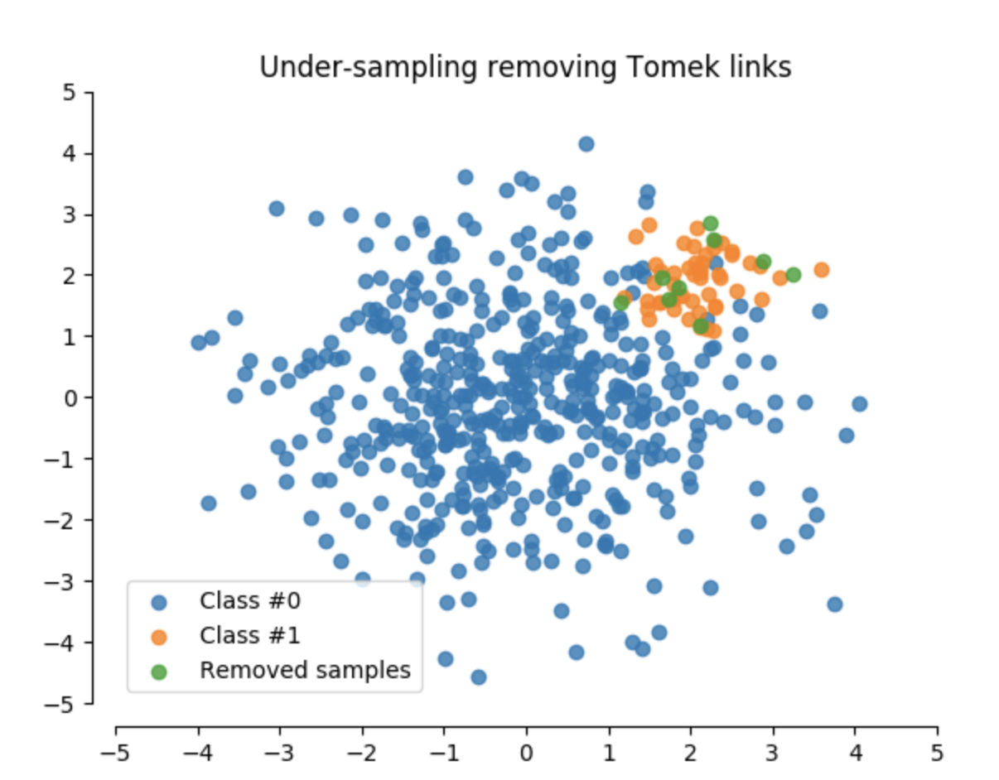
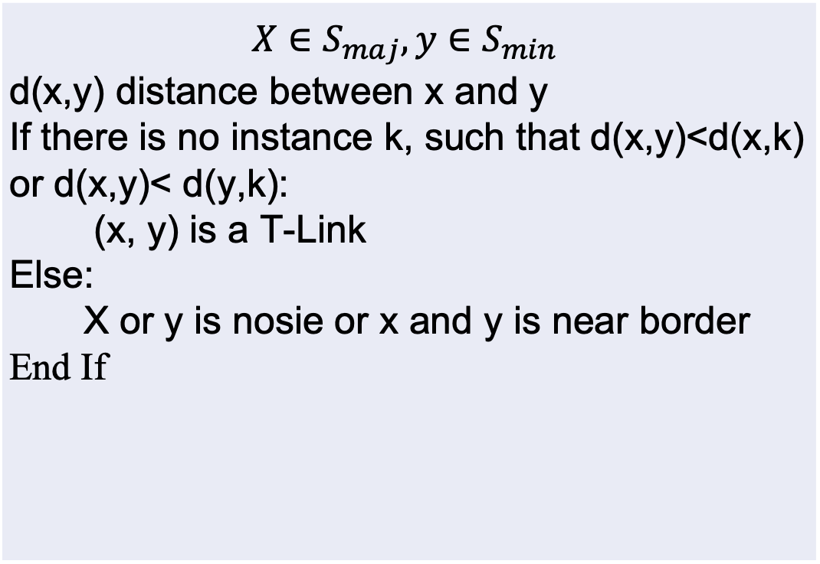
THE STATE-OF-THE-ARTSOLUTIONS
$$X∈S_{maj},y∈S_{min}$$ d(x,y) distance between x and y If there is no instance k, such that d(x,y)<d(x,k) or d(x,y)< d(y,k): (x, y) is a T-Link Else: X or y is nosie or x and y is near border End If

Slide 10
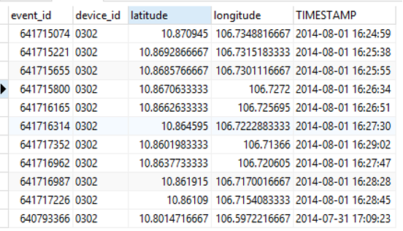
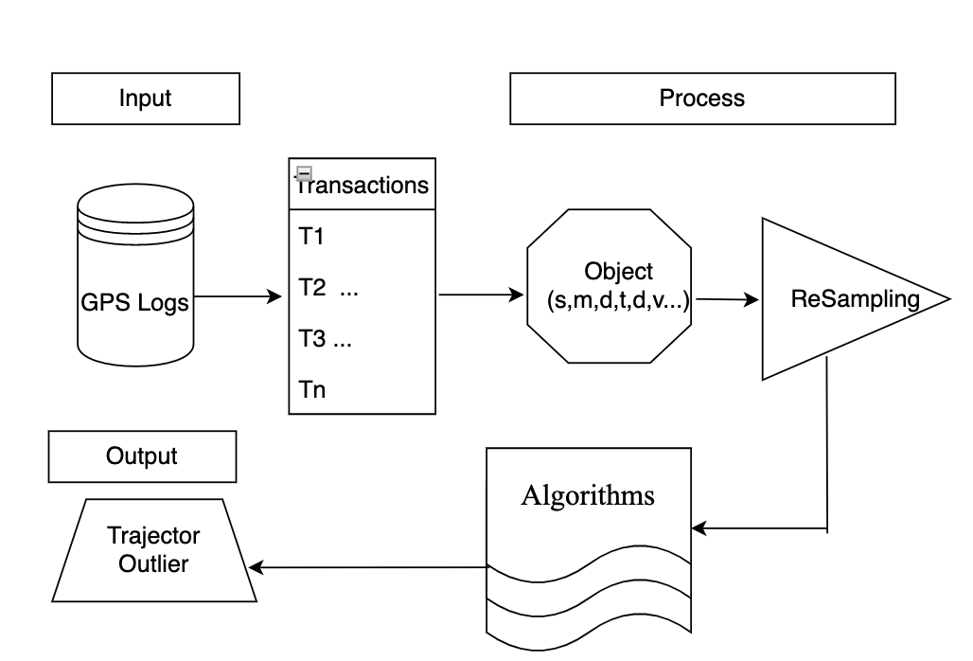
PROPOSED FRAMEWORK
SYSTEM MODEL
SMOTE
ADASYN
T-LINK
…..
GPS point: <id, latitude, longitude, timestamp>
GPS trajectory: GPS points, Same id component, Time order
SVM
LRF
RF
…
GPS dataset or GPS log: a set of GPS trajectories
Notes:
In this section, we describe our framework for detecting sub-trajectories with anomalous motion behavior.
The framework consists of four steps.
The first step is a processing step that extracts trajectories by time frame.
The second step is a feature extraction. We derive objects in the form of a tuple <s,m,d,t,l,v> when s is the start point, m is a midpoint, d is the destination point, t is the timestamp, l is the distance length, and v is the velocity. .
The third step applies techniques to deal with imbalanced data. Finally, in the last step, one can apply any classification algorithm to classify the objects as abnormal or not.

Slide 11
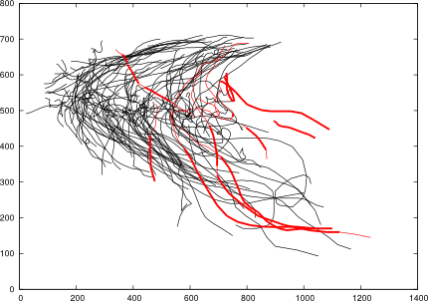
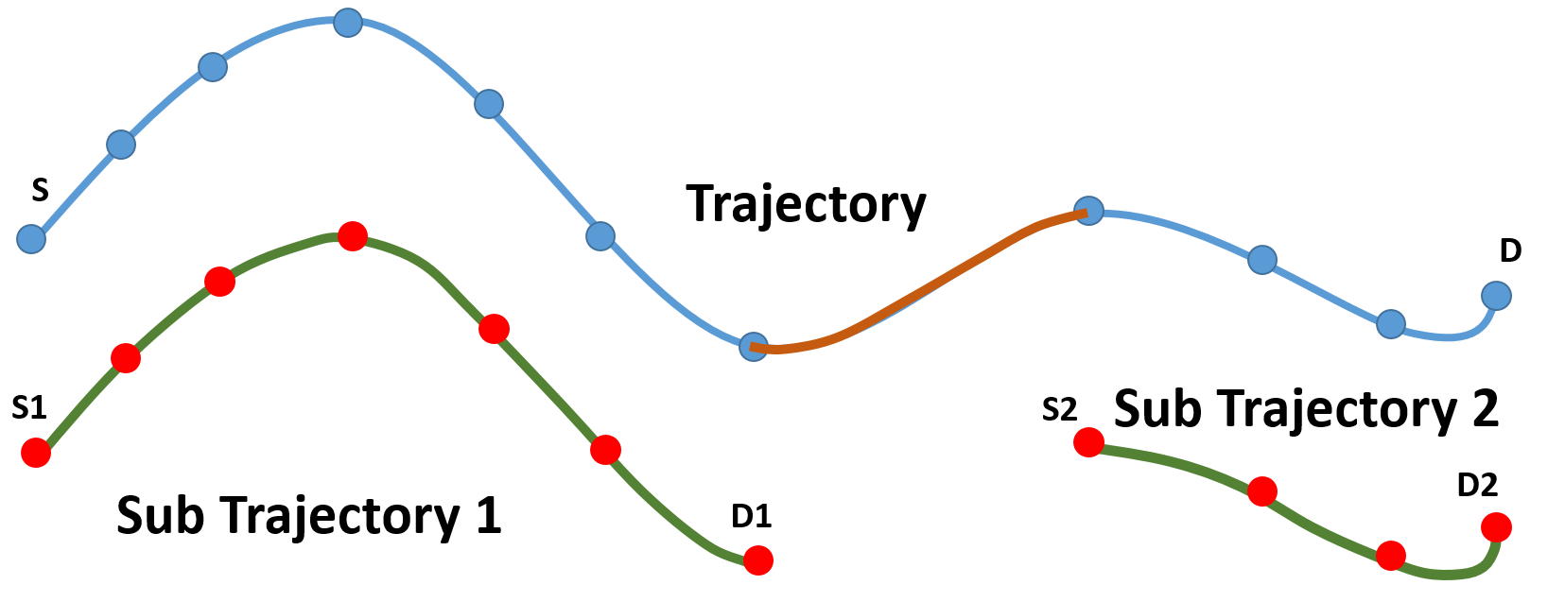
EXPERIMENTAL RESULTS
Experimental Setup
→Split Trajectory(S, D)
Sub Trajectory (S1, D1)
Sub Trajectory (S2, D2)
S ----- D is many routers
t0, t1, t2, t3 …
Detecting outliers based on
distance and density

Slide 12




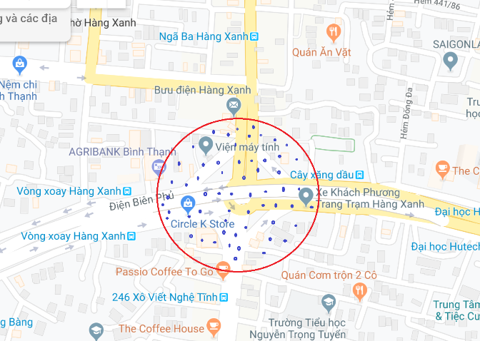
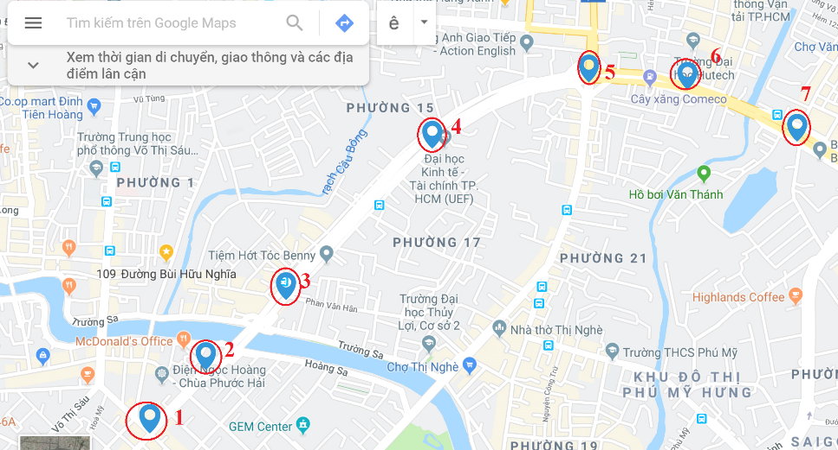
EXPERIMENTAL RESULTS
Dataset Description
We use two data sources to demonstrate our proposed approach
Using data by company OTS
In this dataset : 411 different vehicles, type: bus, truck, taxi, and private car
Moving around Ho Chi Minh City, Vietnam.
From June 01, 2015 to June 07, 2015.

Slide 13
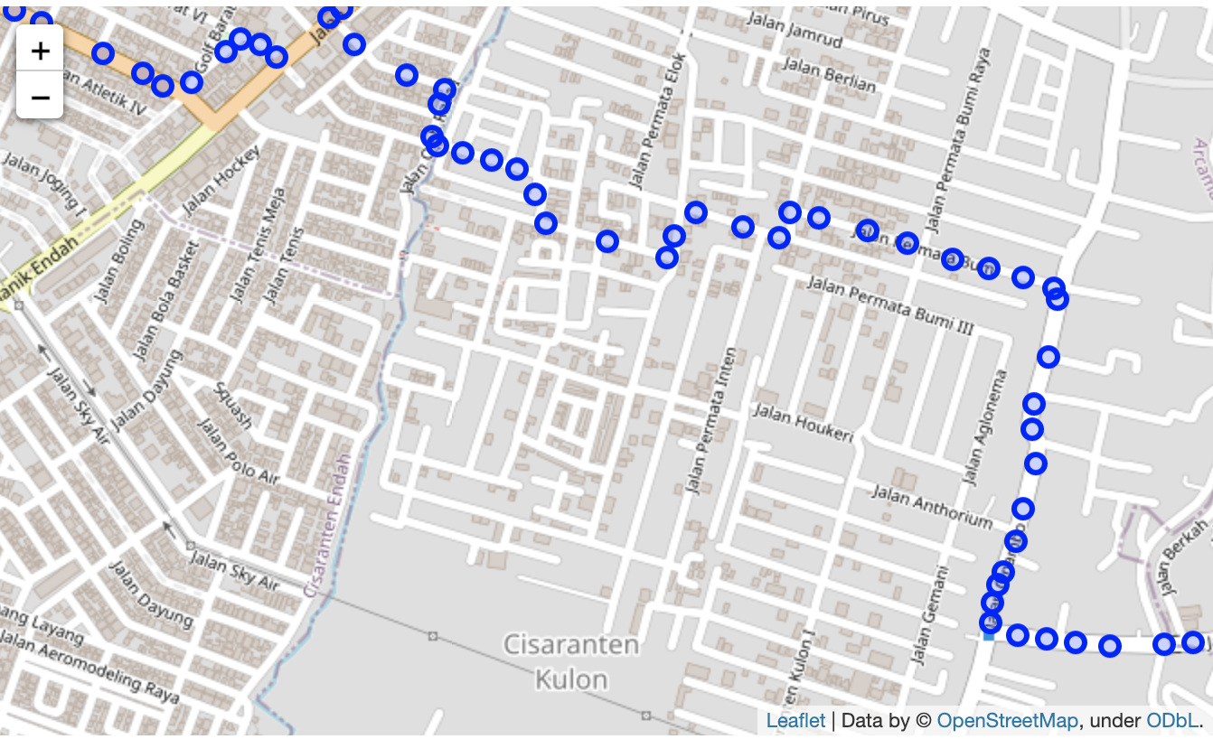
EXPERIMENTAL RESULTS
Dataset Description
Using data by Kaggle website
This dataset contains the GPS trajectories of 10,357 taxis
Beijing-China.
From Feb. 2 to Feb. 8, 2008 .

Slide 14

PERFORMANCE VALUE METRICS
The performance of the model is evaluated using measures such as Weighted accuracy, F-scoere, G-means. The following is a summary of each measure:
$$Sensitivity: The True Positive rate(TP) =\frac{TP}{TP+FN}$$
$$Specificity:The True Negative rate \left(TN\right)=\frac{TN}{FP+TN}$$
$$G−mean=\sqrt{Sensitivity∗Specificity}$$
$$Weighted accuracy=0.5∗(Sensitivity+Specificity)$$
$$Precision=\frac{TP}{TP+FP}$$
$$Recall=\frac{TP}{TP+FN}$$
$F−Score=2\frac{Precision∗Recall}{Precision+Recall}$

Slide 15
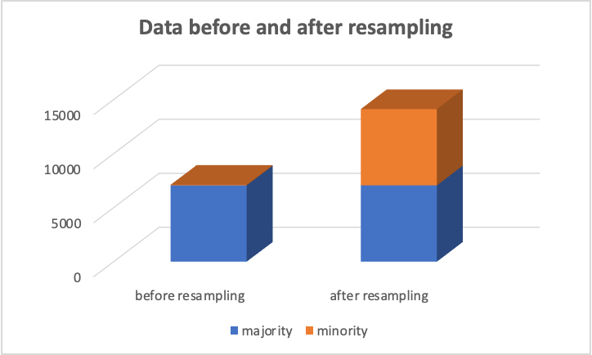
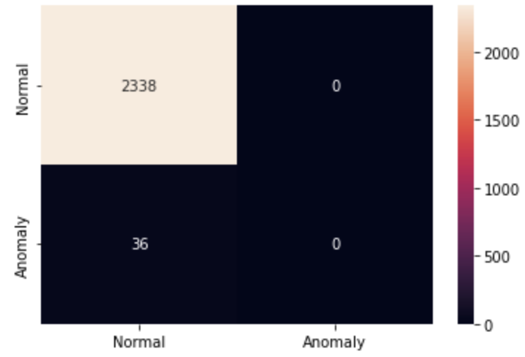
RESULTS
The original data classification model confusion matrix (SVM).
The prediction rate of the majority class is very high, but the minority class is very low.
Therefore, even distribution between classes is very important for classification algorithms.

Slide 16
RESULTS
GPS route data Ho Chi Minh City-Viet Nam
Performance of different ML algorithms using different sampling techniques (Weighted accuracy)

Slide 17
VISUALIZE THE RESULTS
GPS route data Ho Chi Minh City-Viet Nam
Performance of different ML algorithms using different sampling techniques(G-mean)
Performance of different ML algorithms using different sampling techniques(F-score)

Slide 18
RESULTS
GPS route data Shanghai-China (Kaggle website)
Performance of different ML algorithms using different sampling techniques (Weighted accuracy)

Slide 19

VISUALIZE THE RESULTS
GPS route data Shanghai-China (Kaggle website)
Performance of different ML algorithms using different sampling techniques(F-score)
Performance of different ML algorithms using different sampling techniques(G-mean)
The need for preprocessing, and resampling data is very important (All Dataset)

Slide 20
CONCLUTIONS AND FUTURE WORK
Using imbalanced data problems in GPS outlier detection
Prove that it will achieve better performance for the overall process
We demonstrate the effectiveness with real datasets
Apply resampling techniques to the classification models and compare them with the original (unbalanced) data set .
→ Applying resampling techniques -> better results for minority class prediction.
For future work:
Apply deep learning
Optimal threshold of data resampling
improve the predictive model
In this paper, we solve imbalanced data problems in GPS outlier detection and prove that it will achieve better performance for overall process.
The need for preprocessing, and resampling data is very important for the problem of data imbalance in machine learning.
We demonstrate the effectiveness with real datasets, i.e., GPS logs from vehicle tracking services.
We apply resampling techniques to the classification models and compare them with the original (unbalanced) data set.
We find that the application of resampling techniques achieves better results for minority class prediction.
For future work, we are planning to apply deep learning techniques, learn the optimal threshold of data resampling to deal with class imbalance to improve the predictive model.

Slide 21

Q & A

